Slide 1


PLACEMENT DETAILS

Slide 2
MOULYA(17P31A04B4)
K.MADHURI(17A91A04K3)
S.PRAGATHI(18A95A0450)
K.PRAVEEN(17a91a04k2)
MENTOR:
R.SUDHIR

Slide 3
To create and design a
Placement details, registration page , login page and also view the details of placements available
AIM :

Slide 4
XAMPP SERVER
MY Sql
Ngrok
Flask Python web frame
work
Sublime Text
Python Everywhere
TECHNOLGIES USED:

Slide 5
HOME PAGE CONSISTS OF:
VIEW
DETAILS:
The user view the placement details
ADMIN
LOGIN:
The user/admin is redirected to the login page
CONTACT US:
User can contact about any queries and help about placement informations/drives

Slide 6
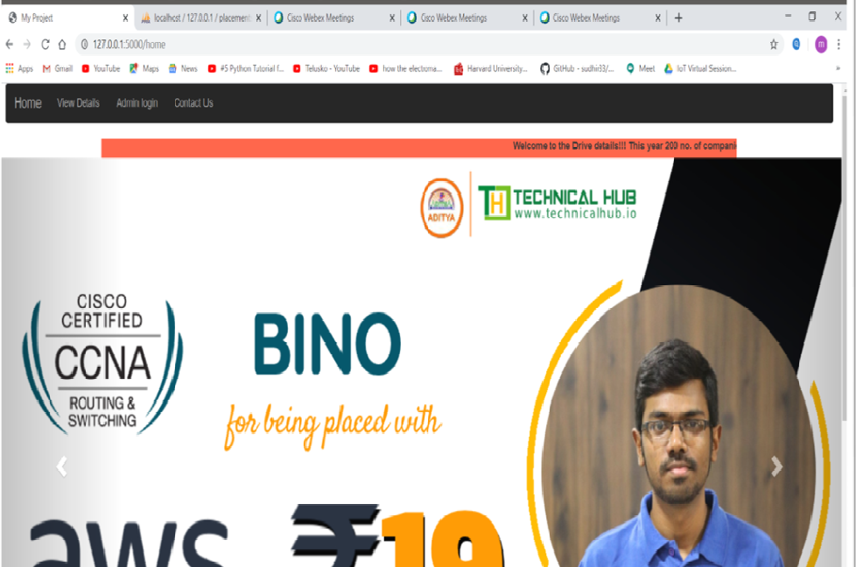

Slide 7
This redirects the user to a page that the user can see the list of upcoming campus drives like eligibility criteria, company name
USER DETAILS:

Slide 8
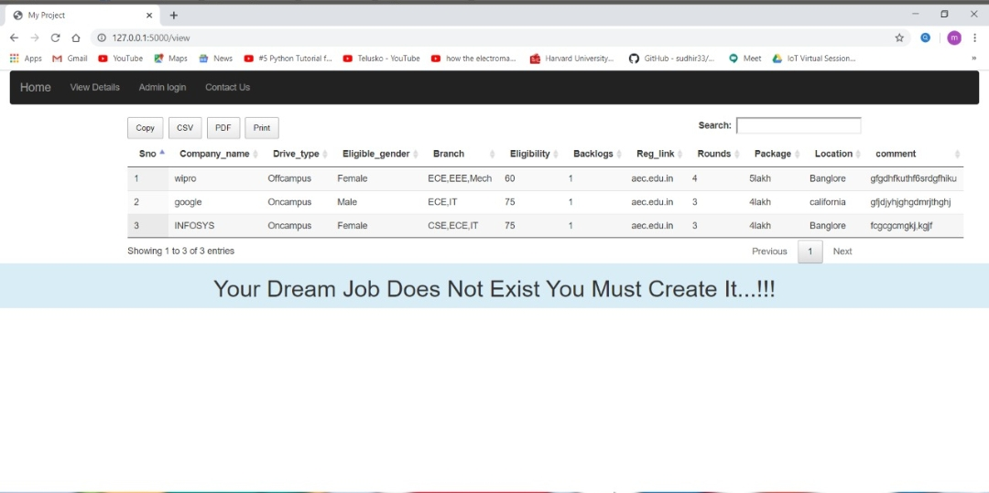

Slide 9

By this page the admin can login by giving the correct user id and password to enter the details
ADMIN LOGIN:

Slide 10
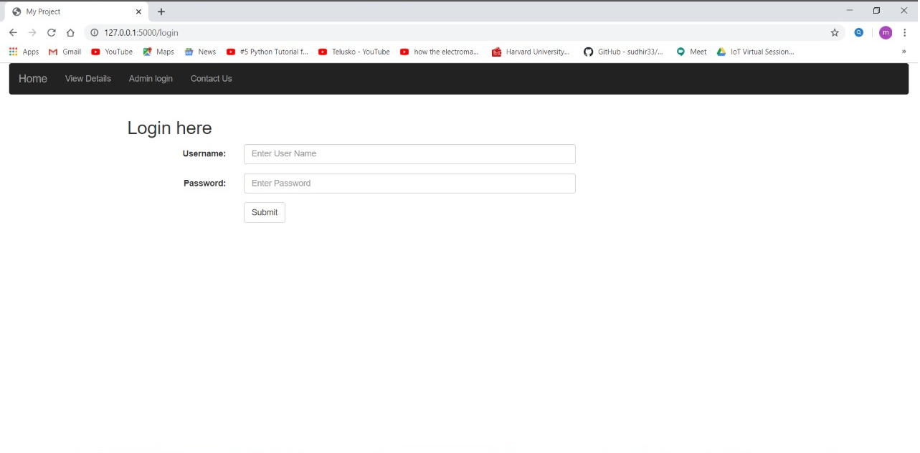

Slide 11
After admin login , the admin is redirected to this page consists of
Enter company details : Here the admin fills the placement details
View upcoming details: This page gives the information about upcoming drive details
View completed details: This gives the list of companies completed the selections.
LOGIN PAGE:

Slide 12

ENTER COMPANY DETAILS:
In this page the admin fills company details like eligibility criteria, drive type…. The admin can edit the details based on the requirements

Slide 13
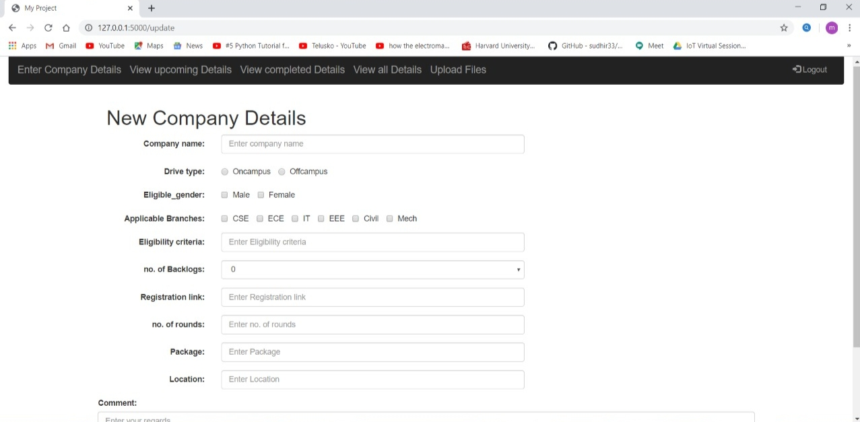

Slide 14
This redirects the admin to a page that the admin
can see the list of upcoming campus drives details like eligibility criteria, company name
The admin can edit or delete or close the details based on requirements and conditions
VIEW UPCOMING
DETAILS :

Slide 15
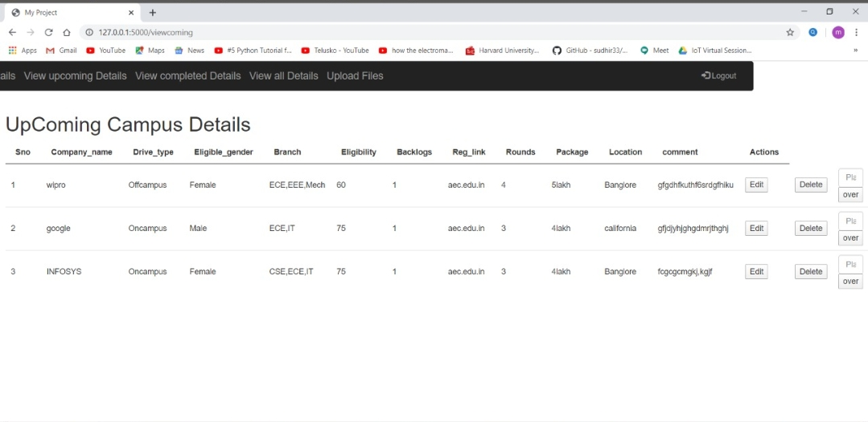

Slide 16
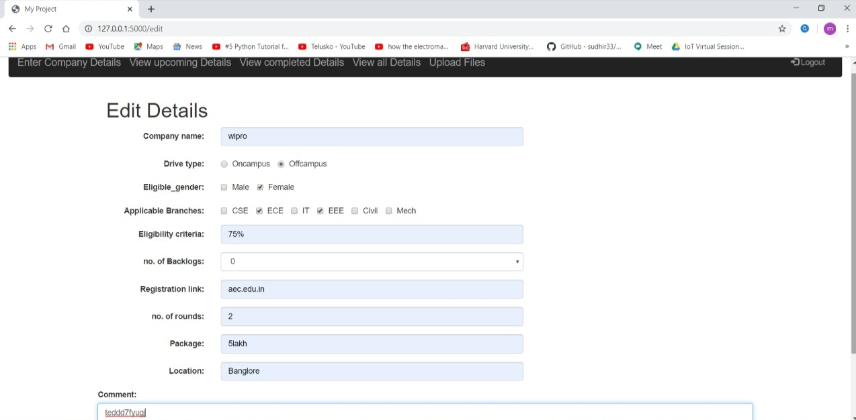

Slide 17
This redirects the admin to a page that the admin can see the list of completed campus details and how many members are placed in the company
VIEW COMPLETED DETAILS:

Slide 18
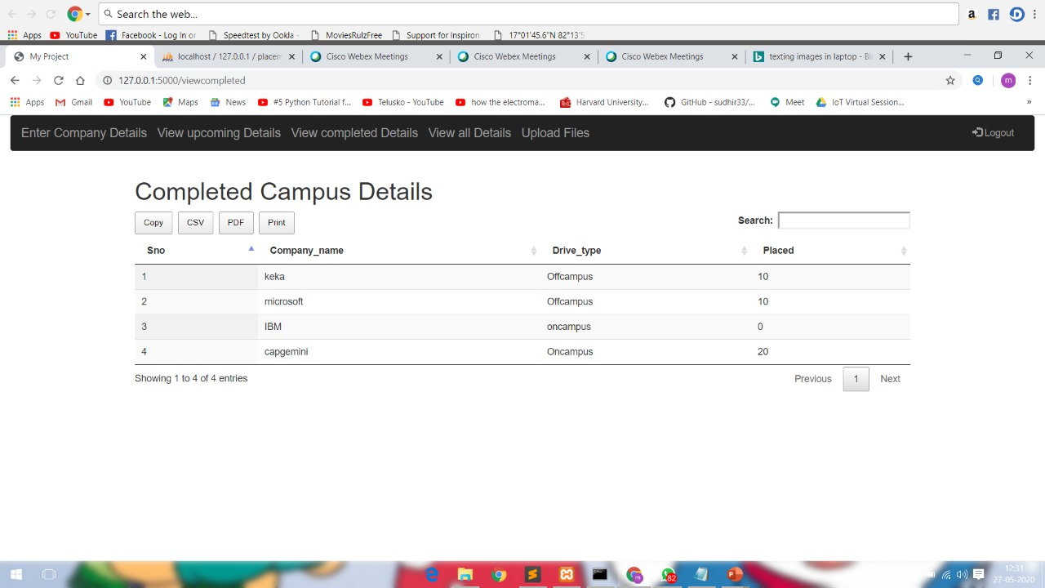

Slide 19
This redirects the admin to a page that the admin can see the list of all campus drive details such as upcoming campus details and completed campus drive details.
VIEW ALL
DETAILS:

Slide 20
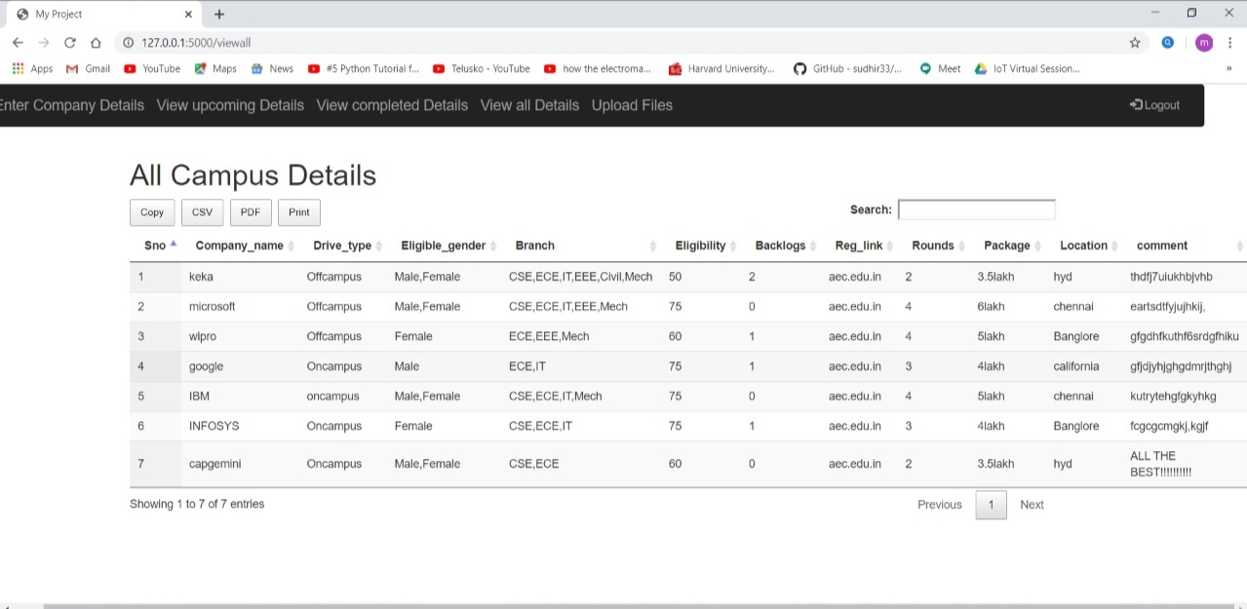

Slide 21
The user can contact about any queries/help about placement information /drives
CONTACT US:

Slide 22
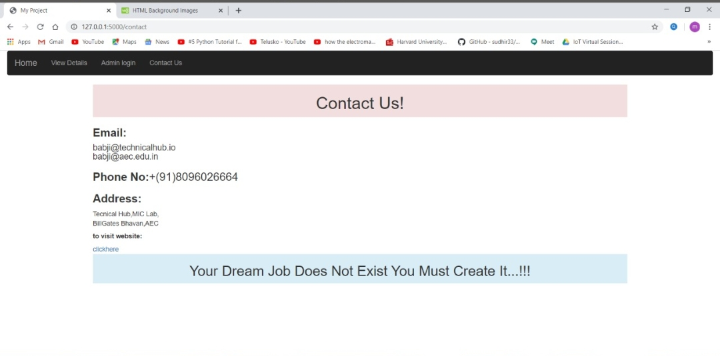


Slide 23


